Slide 1
Chapter 8 – Software Testing
Instructor
Dr. Sultan S. Alqahtani
ssalqahtani@imamu.edu.sa
Note: These are a slightly modified version of Ch8 slides available from the author’s site http://www.cs.st-andrews.ac.uk/~ifs/Books/SE9/

Slide 2
Topics covered
Development testing
Test-driven development
Release testing
User testing

Slide 3
Quiz
Name three common activities of object-oriented design process.
[True/False] Identifying object classes is often a easy part of object oriented design.
What is the difference between static model and dynamic model?

Slide 4
Program testing
Testing is intended to show that a program does what it is intended to do and to discover program defects before it is put into use.
When you test software, you execute a program using artificial data.
You check the results of the test run for errors, anomalies or information about the program’s non-functional attributes.
Can reveal the presence of errors NOT their absence.
Testing is part of a more general verification and validation process, which also includes static validation techniques.

Slide 5
Program testing goals
To demonstrate to the developer and the customer that the software meets its requirements.
To discover situations in which the behavior of the software is incorrect, undesirable or does not conform to its specification.

Slide 6
The first goal leads to validation testing
The second goal leads to defect testing

Slide 7
Testing process goals
Validation testing
To demonstrate to the developer and the system customer that the software meets its requirements
A successful test shows that the system operates as intended.
Defect testing
To discover faults or defects in the software where its behavior is incorrect or not in conformance with its specification
A successful test is a test that makes the system perform incorrectly and so exposes a defect in the system.

Slide 8
Verification vs validation
Verification: "Are we building the product right”.
The software should conform to its specification.
Validation: "Are we building the right product”.
The software should do what the user really requires.

Slide 9
V & V confidence
Aim of V & V is to establish confidence that the system is ‘fit for purpose’.
Depends on system’s purpose, user expectations and marketing environment
Software purpose
The level of confidence depends on how critical the software is to an organisation.
User expectations
Users may have low expectations of certain kinds of software.
Marketing environment
Getting a product to market early may be more important than finding defects in the program.

Slide 10
Inspections and testing
Software inspections Concerned with analysis of the static system representation to discover problems (static verification)
May be supplement by tool-based document and code analysis.
Software testing Concerned with exercising and observing product behaviour (dynamic verification)
The system is executed with test data and its operational behaviour is observed.

Slide 11
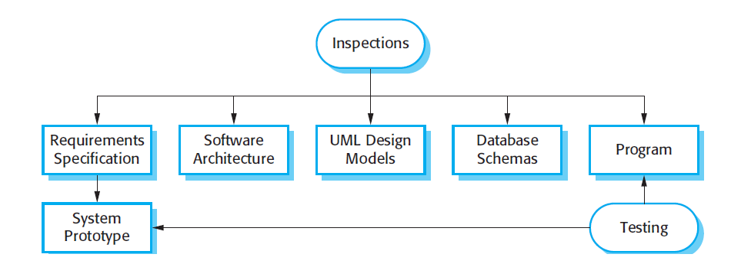
Inspections and testing

Slide 12
Inspections and testing
Inspections and testing are complementary and not opposing verification techniques.
Both should be used during the V & V process.
Inspections can check conformance with a specification but not conformance with the customer’s real requirements.
Inspections cannot check non-functional characteristics such as performance, usability, etc.

Slide 13
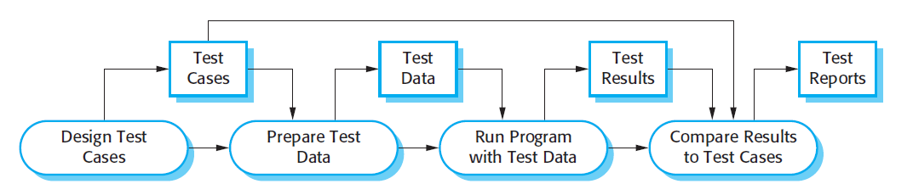
A model of the software testing process

Slide 14
Stages of testing
Development testing, where the system is tested during development to discover bugs and defects.
Release testing, where a separate testing team test a complete version of the system before it is released to users.
User testing, where users or potential users of a system test the system in their own environment.

Slide 15
Development testing
Development testing includes all testing activities that are carried out by the team developing the system.
Unit testing
Component (Integration) testing
System testing

Slide 16
Unit testing
Unit testing is the process of testing individual components in isolation.
It is a defect testing process.
Units may be:
Individual functions or methods within an object
Object classes with several attributes and methods
Composite components with defined interfaces used to access their functionality.

Slide 17
Object class testing
Complete test coverage of a class involves
Testing all operations associated with an object
Setting and interrogating all object attributes
Exercising the object in all possible states.
Inheritance makes it more difficult to design object class tests as the information to be tested is not localised.

Slide 18
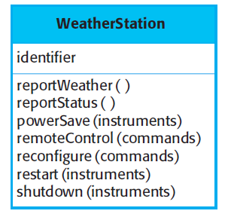
The weather station object interface

Slide 19
Weather station testing
Need to define test cases for reportWeather, calibrate, test, startup and shutdown.
Using a state model, identify sequences of state transitions to be tested and the event sequences to cause these transitions
For example:
Shutdown -> Running-> Shutdown
Configuring-> Running-> Testing -> Transmitting -> Running
Running-> Collecting-> Running-> Summarizing -> Transmitting -> Running

Slide 20
Automated testing
Whenever possible, unit testing should be automated so that tests are run and checked without manual intervention.
In automated unit testing, you make use of a test automation framework (such as JUnit) to write and run your program tests.
Tutorial: https://www.ece.uvic.ca/~shsaad/seng426/resources/Lab%20Slides/Lab3-SENG09.pdf

Slide 21
Key points
Testing can only show the presence of errors in a program. It cannot demonstrate that there are no remaining faults.
Development testing is the responsibility of the software development team. A separate team should be responsible for testing a system before it is released to customers.
Development testing includes unit testing, in which you test individual objects and methods component testing in which you test related groups of objects and system testing, in which you test partial or complete systems.

Slide 22
Chapter 8 – Software Testing
Lecture 2

Slide 23
Component testing
Software components are often composite components that are made up of several interacting objects.
For example, in the weather station system, the reconfiguration component includes objects that deal with each aspect of the reconfiguration.
Testing composite components should therefore focus on showing that the component interface behaves according to its specification.

Slide 24
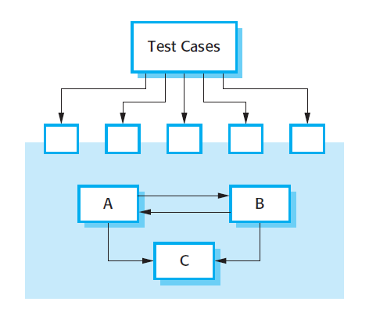
Interface testing

Slide 25
Interface errors
Interface misuse
A calling component calls another component and makes an error in its use of its interface e.g. parameters in the wrong order.
Interface misunderstanding
A calling component embeds assumptions about the behaviour of the called component which are incorrect.
Timing errors
The called and the calling component operate at different speeds and out-of-date information is accessed.

Slide 26
System testing
System testing during development involves integrating components to create a version of the system and then testing the integrated system.
The focus in system testing is testing the interactions between components.
System testing checks that components are compatible, interact correctly and transfer the right data at the right time across their interfaces.
System testing tests the emergent behavior of a system.

Slide 27
System and component testing
During system testing, reusable components that have been separately developed and off-the-shelf systems may be integrated with newly developed components. The complete system is then tested.
Components developed by different team members or sub-teams may be integrated at this stage. System testing is a collective rather than an individual process.

Slide 28
Use-case testing
The use-cases developed to identify system interactions can be used as a basis for system testing.
Each use case usually involves several system components so testing the use case forces these interactions to occur.
The sequence diagrams associated with the use case documents the components and interactions that are being tested.

Slide 29
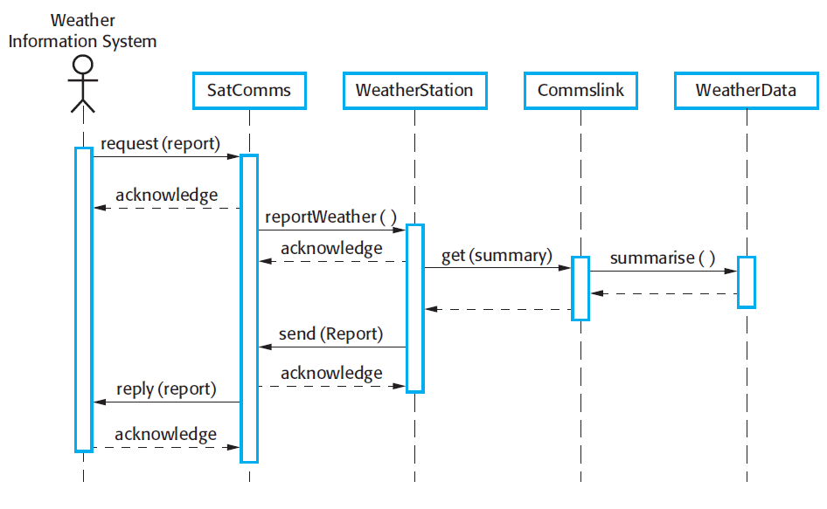
Collect weather data sequence chart
An input request for a report to WeatherStation results in a summarized report being generated. You can test this in isolation by creating raw data corresponding to the summary that you have prepared for the test of SatComms and checking that the WeatherStation object correctly produces this summary. This raw data is also used to test the WeatherData object.

Slide 30
Test-driven development
Test-driven development (TDD) is an approach to program development in which you inter-leave testing and code development.
Tests are written before code and ‘passing’ the tests is the critical driver of development.
You develop code incrementally, along with a test for that increment. You don’t move on to the next increment until the code that you have developed passes its test.
TDD was introduced as part of agile methods such as Extreme Programming. However, it can also be used in plan-driven development processes.

Slide 31
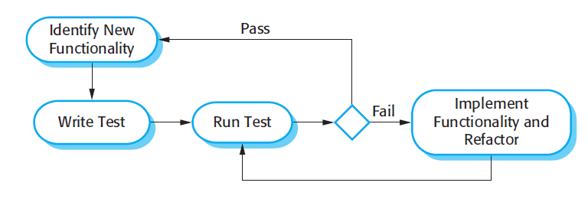
Test-driven development

Slide 32
Benefits of test-driven development
Code coverage
Every code segment that you write has at least one associated test so all code written has at least one test.
Regression testing
A regression test suite is developed incrementally as a program is developed.
Simplified debugging
When a test fails, it should be obvious where the problem lies. The newly written code needs to be checked and modified.
System documentation
The tests themselves are a form of documentation that describe what the code should be doing.

Slide 33
Regression testing
Regression testing is testing the system to check that changes have not ‘broken’ previously working code.
In a manual testing process, regression testing is expensive but, with automated testing, it is simple and straightforward. All tests are rerun every time a change is made to the program.
Tests must run ‘successfully’ before the change is committed.

Slide 34
Release testing
Release testing is the process of testing a particular release of a system that is intended for use outside of the development team.
The primary goal of the release testing process is to convince the supplier of the system that it is good enough for use.
Release testing, therefore, has to show that the system delivers its specified functionality, performance and dependability, and that it does not fail during normal use.
Release testing is usually a black-box testing process where tests are only derived from the system specification.

Slide 35
Release testing and system testing
Release testing is a form of system testing.
Important differences:
A separate team that has not been involved in the system development, should be responsible for release testing.
System testing by the development team should focus on discovering bugs in the system (defect testing). The objective of release testing is to check that the system meets its requirements and is good enough for external use (validation testing).

Slide 36
User testing
User or customer testing is a stage in the testing process in which users or customers provide input and advice on system testing.
User testing is essential, even when comprehensive system and release testing have been carried out (WHY?)
The reason for this is that influences from the user’s working environment have a major effect on the reliability, performance, usability and robustness of a system. These cannot be replicated in a testing environment.

Slide 37
Types of user testing
Alpha testing
Users of the software work with the development team to test the software at the developer’s site.
Beta testing
A release of the software is made available to users to allow them to experiment and to raise problems that they discover with the system developers.
Acceptance testing
Customers test a system to decide whether or not it is ready to be accepted from the system developers and deployed in the customer environment. Primarily for custom systems.

Slide 38
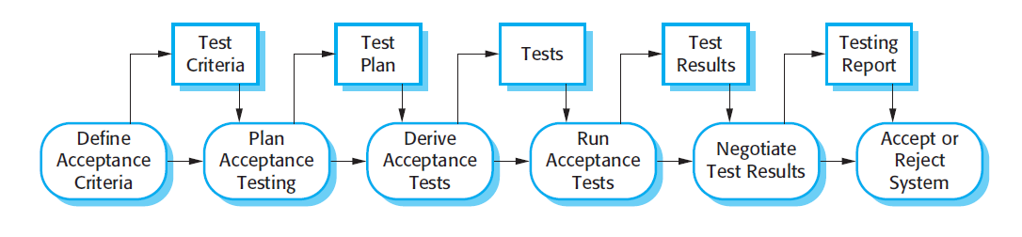
The acceptance testing process

Slide 39
Stages in the acceptance testing process
Define acceptance criteria
Plan acceptance testing
Derive acceptance tests
Run acceptance tests
Negotiate test results
Reject/accept system

Slide 40
Agile methods and acceptance testing
In agile methods, the user/customer is part of the development team and is responsible for making decisions on the acceptability of the system.
Tests are defined by the user/customer and are integrated with other tests in that they are run automatically when changes are made.
There is no separate acceptance testing process.
Main problem here is whether or not the embedded user is ‘typical’ and can represent the interests of all system stakeholders.

Slide 41
Key points
When testing software, you should try to ‘break’ the software by using experience and guidelines to choose types of test case that have been effective in discovering defects in other systems.
Wherever possible, you should write automated tests. The tests are embedded in a program that can be run every time a change is made to a system.
Test-first development is an approach to development where tests are written before the code to be tested.
Scenario testing involves inventing a typical usage scenario and using this to derive test cases.
Acceptance testing is a user testing process where the aim is to decide if the software is good enough to be deployed and used in its operational environment.

